Slide 1
UNDERSTANDING BRITISH VALUES
A PRESENTATION FOR PUPILS
Last updated: 4 February 2019

Slide 2
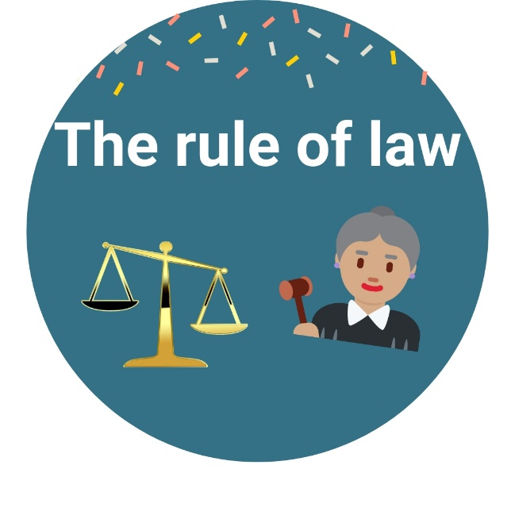
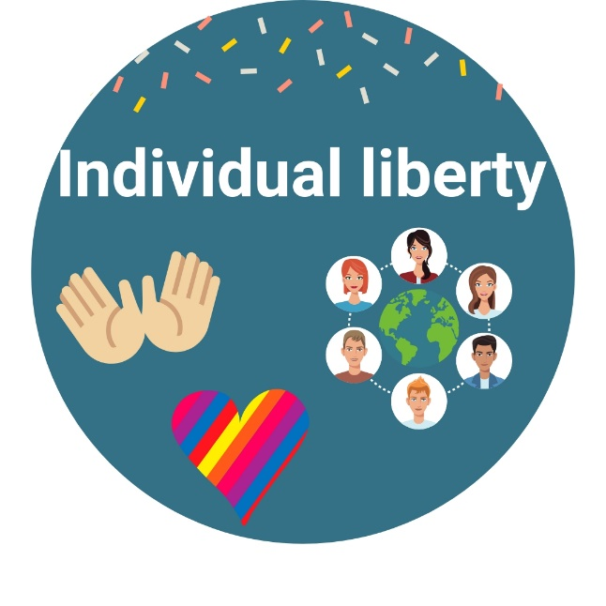
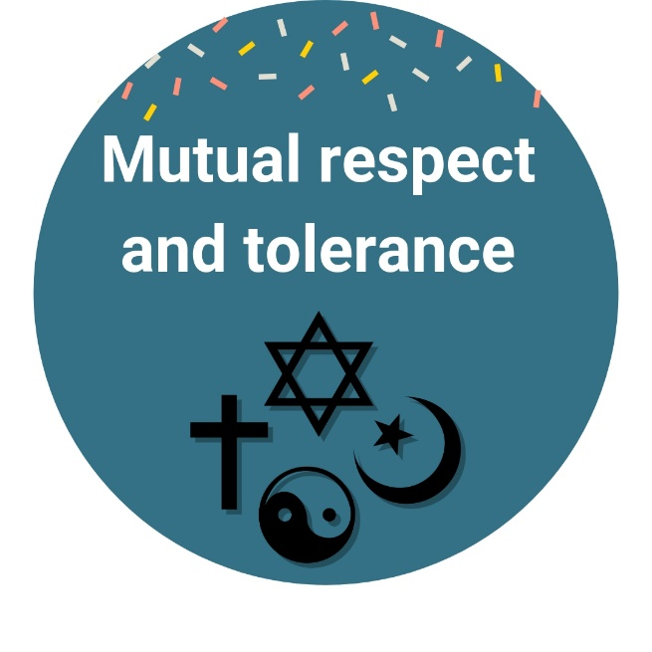
The four British values
Fundamental British values
There are four important values that summarise what it means to be a citizen of Great Britain today. Every person in Britain should have respect for the values and live by them.
The four values are:
Notes:
Animations appear on click

Slide 3
Important words
Liberty: The overall freedom of an individual or nation.
Autonomy: The ability to act on your own, and based on what you believe in and what you think is important in life.
Tolerance: The acceptance and understanding of other people’s behaviour and beliefs even if you do not agree with them.
Gender identity: A person’s internal sense of their own gender. This could be male, female, or something else.
Diversity: The difference between people and objects in any given situation.
Stereotype: The ways that we expect people to behave in society, e.g. expecting all boys to like blue and all girls to like pink.

Slide 4
Democracy
Britain is a democratic nation – but what does this mean?
To be in a democracy means that the people who live in a country vote on the way it is run. It promotes freedom and equality and everyone is aware of their rights and responsibilities.
People aged 18 and over can vote for matters, e.g. for the next Prime Minister. This means that they get the opportunity to listen to different points of view, policies or practices and then vote for the one they want the most.
This is important because it gives people the chance to have their say on how they live their life. It gives power to the people to make important changes.

Slide 5
Being in a democracy is not restricted to how the country is run. Schools can also run in a democratic way.
We mirror the democratic process by getting you, the pupils, to vote on things that are important to you and your education so you have an influence on the decisions made in school. We do this because we think it is essential that you enjoy your education; we respect your opinions and want you to have fun at school.
Here are a few things you have changed already at school:
School dinners
Class council
New play equipment
School uniform

Slide 6
The rule of law
Britain has a set of laws that are in place to keep its people safe and free from harm. If you break a law you could go to prison for a long time. Laws are there to protect us, ensuring we are able to live happy lives in a secure environment.
Laws are essential for our wellbeing and this is why we have organisations such as the army and the police to keep us safe and protect us and our borders from danger.
If someone breaks the law, they will be arrested and put on trial by a court of law. This is where a Judge and Jury will decide on whether the person is innocent or guilty, and how they will be punished if they are guilty.
Everyone in Britain is able to have a fair trial – this means that people will not be disciplined for unjustified reasons. When someone is disciplined for unjust reasons this is known as discrimination.

Slide 7
Discrimination
Discrimination means treating people less favourably or differently because of their:
Age
Disability
Gender (or gender reassignment)
Marriage or civil partnership
Pregnancy or maternity
Race
Religion or belief
Sex
Sexual orientation
It is against the law to treat people differently because of any of the above and you can be disciplined if you do so.
Notes:
Animations will appear on click

Slide 8
Think about the following context
The local newspaper has a vacancy for a new journalist to write about the weekly football matches.
Meet the candidates

Slide 9
Susie
Susie applied for the job. She:
Is aged 22.
Is a woman.
Lives close to the newspaper.
Has a English language degree.
Has two years’ experience of writing for newspapers.
Has a keen interest in sports.

Slide 10
Jack
Jack applied for the job. He:
Is aged 22.
Is a man.
Lives close to the newspaper.
Has a English language degree.
Has one year of experience writing for newspapers.
Has not got a keen interest in sports.

Slide 11
By show of hands, who do you think got the job?
Or
Notes:
Let pupils decide on who was employed depending on the criteria provided in the previous slides

Slide 12
The boss of the company employed…
Jack!
Even though Jack had less experience and clearly didn’t have the same love for sports as Susie did, the employers hired him.
What we didn’t know is that after the interviews were over, a work colleague overheard the boss saying “well the girl was good, but she is a woman. She won’t know anything about sports, so we can’t give the job to her”.
Raise your hands if you this was the right reason for not employing Susie.

Slide 13
The boss of the newspaper had discriminated against Susie based on her gender. This is wrong and punishable by law. Nobody should ever be discriminated against based on any of the nine protected characteristics we have seen – it is illegal.

Slide 14
Individual liberty
Just as it is ok for other people to be different, it is also ok for you to be different!
British law protects individual’s liberty – citizens of the UK can live how they choose within the limits of the law. You can practise any faith you choose, live wherever you want and you can have any job you put your mind to.
We also like encouraging differences in school. We like learning about you and what makes you different. In school, you have liberty to:
Attend after-school clubs of your choice
Bring in your own books and stationary
Listen to music at breaktimes

Slide 15
You make a lot of choices every day that can influence how you live your life!
Raise your hands if you think you have a choice over the following things:
Friendships
Playtime games
Relationships
Your safety
Lunch menu
After-school clubs
What you learn
Notes:
Animations appear on click

Slide 16
You should always be respectful of other people’s choices and, in turn, people should show you the same respect for the choices you make.
As long as you are not causing harm to yourself or other people through the choices you make, then you should embrace and celebrate them.
If you want to make any big changes in your life or you feel like you enjoy things that are different to your friends, you can always talk to a teacher or member of staff about them. We will always be there to support your choices and help you where possible.

Slide 17
It is important to remember that it is good to be different and we should celebrate everyone’s differences as well as our similarities.
Knowing different people can teach us things we didn’t know about ourselves and the world. It is exciting to learn new things and we will understand people better if we try and get to know them.
Sally is 15 years old and was born in Manchester
Hello everyone!
Sally goes to a Christian church every Sunday
Sally is a girl
Sally has a lot of friends
Sally’s favourite meal is spaghetti carbonara
Sally likes swimming
Sally is disabled from the waist down
Meet Sally
Notes:
Animations appear on click

Slide 18
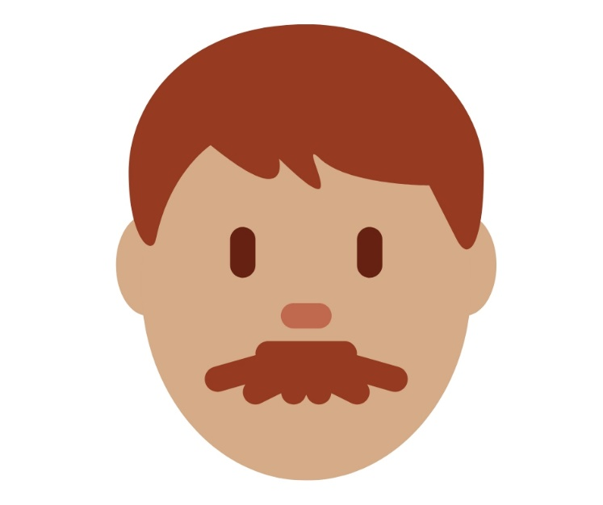
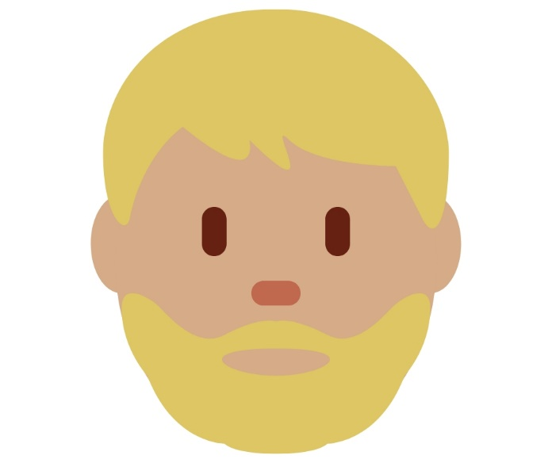
Here is Sally’s mum
Here are Sally’s Dads
Sally is a very happy girl who loves her parents and they love her very much!
Sadly, Sally gets bullied at school – people laugh at her for having three parents.
Sally
Notes:
Animations appear on click

Slide 19
Raise your hand if you think it is wrong that Sally is being bullied.
Keep your hand raised if you think the children who are bullying Sally should be punished.
You don’t need one mum and one dad to make a family. A family can be made up of a single parent and a child, or parents who adopted or fostered their child or even a child being raised by relations such as grandparents. What truly matters is that whoever proves you care loves you and keeps you safe and free from harm.
Remember: nobody should be bullied for being who they are or their families. We should learn about our friends and respect their differences. It is ok to ask questions about their differences if you don’t understand, but never be rude or nasty towards them.
Our school has a zero-tolerance attitude towards bullying. This means that if you ever bully someone else you will be disciplined – this could be through a warning, detention or exclusion.
Notes:
Animation appears on click

Slide 20
LGBTQ+
Lesbian – a word to describe a woman who falls in love with or wants to have a relationship with other women.
Gay – a word to describe a man who falls in love with or wants to have a relationship with other men e.g. Sally’s dads.
Heterosexual – a word to describe someone who falls in love with or wants to have a relationship with someone of the opposite gender as them.
Bisexual – a word to describe someone who falls in love with or wants to have a relationship with someone of the same or different gender as them.
Trans* – a word that describes people who feel the gender they were given as a baby doesn’t match the gender they feel themselves to be.
Queer – in the past this has been a derogatory term for LGBTQ+ individuals. The term now refers to people who don’t identify with traditional categories around gender identity and sexual orientation, but it is still viewed to be derogatory by some.
+ – this is used to refer to anyone who identifies as anything else regarding sexuality.

Slide 21
You may know someone who identifies of any of the previous identities; either your friend, family member or even yourself. It doesn’t matter how people identify, it doesn’t make them better or worse than other people! We should celebrate being different – the world would be a pretty boring place if everyone was exactly the same!

Slide 22
Homophobic bullying
Homophobic bullying is when someone is nasty to a person based on who they fall in love with, i.e. sexual orientation.
We do not accept any form of bullying at our school and anyone who is found to have been bullying their peer will be disciplined.
Words and phrases we do not want to hear:
‘That’s so gay’ or ‘you’re so gay’
‘Don’t be such a girl’ or ‘you kick like a girl’
Referring to a bisexual person as ‘greedy’ or ‘attention seeking’
Referring to someone as a ‘it’ or ‘he-she’
Notes:
Animations appear on click

Slide 23
Mutual respect and tolerance
As we have seen with individual liberty, we have the right to choose the way we live – this includes lifestyle choices and faiths. This value ensures people have a good attitude towards others, and recognise and respects the individual liberty of others. Even if you don’t agree with what someone believes, you should respect their choices to try and understand why they believe what they do.
Cultural differences
Britain is multicultural – this means that it has a lot of people living in it who come from different backgrounds and live lives that may be different to how your family lives theirs. There is no one right way to live and these differences should be celebrated. Remember: we learn and grow together and it is important not to judge people before you get to know them.
This can be achieved by:
Learning some basic greetings in a different language
Learning about different cultural festivals
Trying different cuisine
Notes:
The following slide teaching pupils how to say hello in different languages as an example of how pupils can learn about different cultures. The first bullet point will turn yellow to signify this is an example you will be working on together during the assembly.

Slide 24
Hello
English
Hej
Oi
Salut
Danish
Portuguese
French
Ciao
Hallá
Italian
Hola
Hallo
Swedish
Spanish
German
Notes:
Animations appear on click

Slide 25
Religion
There are many different communities within the UK that practise different faiths and religions e.g. Christianity, Catholicism, Judaism and Islam to name a few. At school we practise Judaism. This means we practice the core values of Judaism throughout the school day e.g. in assemblies.
It is important we learn about different faiths so that we can understand them and the values they promote. Being culturally aware helps you expand your knowledge of other people and their values. We have to be tolerant of people even if they do not believe in the same things as ourselves, whether that is religion, faith or lifestyle choices.
At school, we teach about different cultures and religions through PSHE lessons and RSE. If you feel like you don’t understand something or you want to learn more, you can always discuss these topics with your teacher.

Slide 26
True or false
By show of hands, who thinks the following is true or false:
The four British values are: democracy, liberty, rule of law and mutual tolerance and respect. True or false?
It isn’t against the law to discriminate against the nine protected characteristics. True or false?
Tolerance means being accepting of other people’s thoughts and beliefs even if you don’t agree with them. True or false?
The school values the opinions of its pupils and tries to apply democratic practises. True or false?
Notes:
True or false appears on click – green is true and red is false

Slide 27
Summary
What have we learnt today?
There are four fundamental British values: democracy, liberty, rule of law and mutual tolerance and respect
It is important to be accepting of other people even if they don’t share or values and beliefs – this is otherwise know as tolerance.
There are nine protected characteristics that are protected by law
We live in a democracy – this means that we are governed by leaders who have been selected by the people. This is something we also practice in school.
Being different is something to be celebrated and we should always be trying to learn different things about ourselves and others.
It is ok to ask questions if you don’t understand anything to do with the British values.
You have a strong support network here at school if you want to discuss any issues you may have.
Notes:
Animations appear on click

