Slide 1
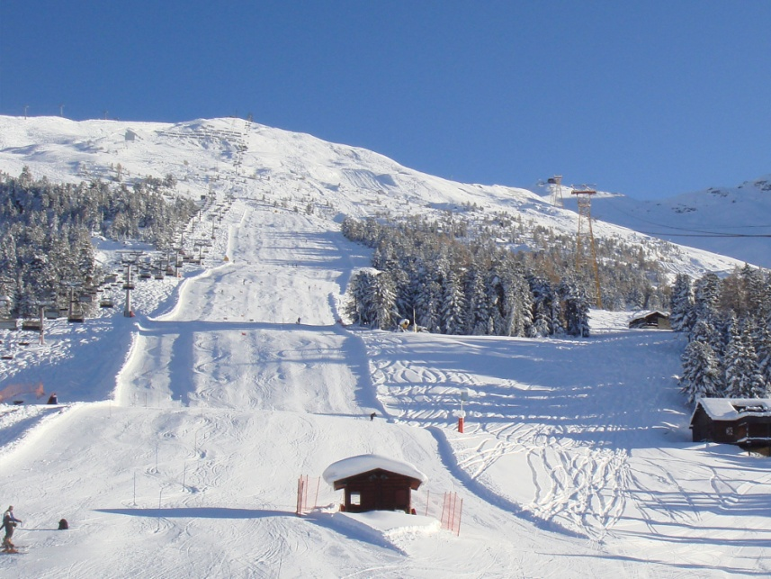
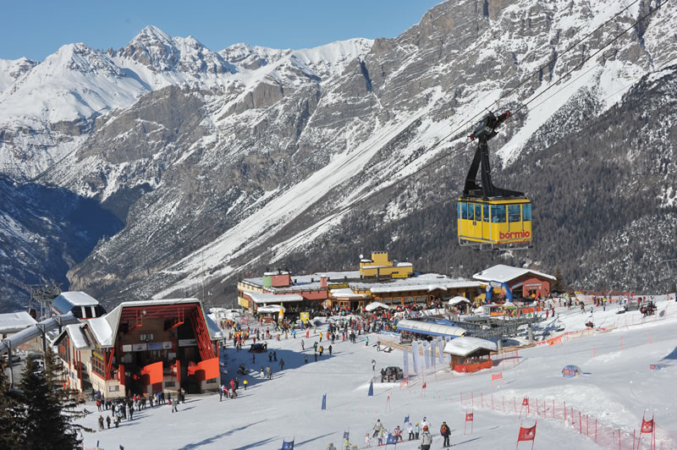
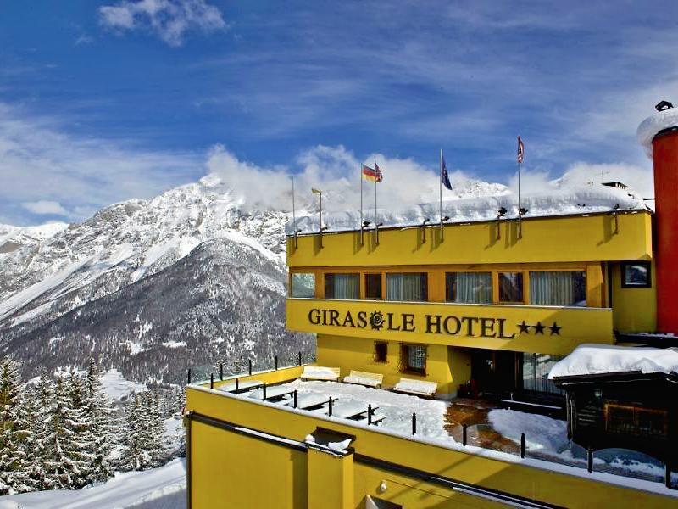
Blessed Sacrament Ski Trip 2023
Bormio, Italy

Slide 2
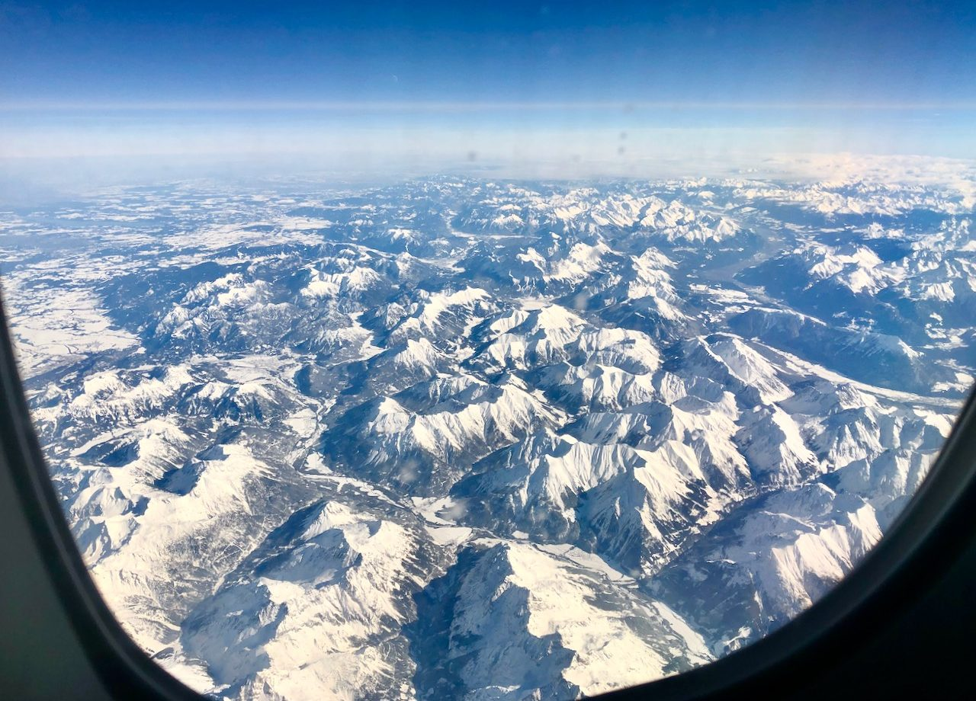
Travel Arrangements
Saturday 18th March
Children to meet at B&Q on Edge Lane at 4.00am Saturday morning
Ryanair Flight: FR9877 from Manchester 8.15am
Arrives Turin at 11.20am
Transfer to Bormio is 4 hours
Saturday 25th March
Ryanair flight: FR9876
Leaves Turin at 11.45am and arrives in Manchester at 12.50pm
Approximate coach arrival at Blessed Sacrament is 3.00pm
We will contact you if there are any significant delays

Slide 3
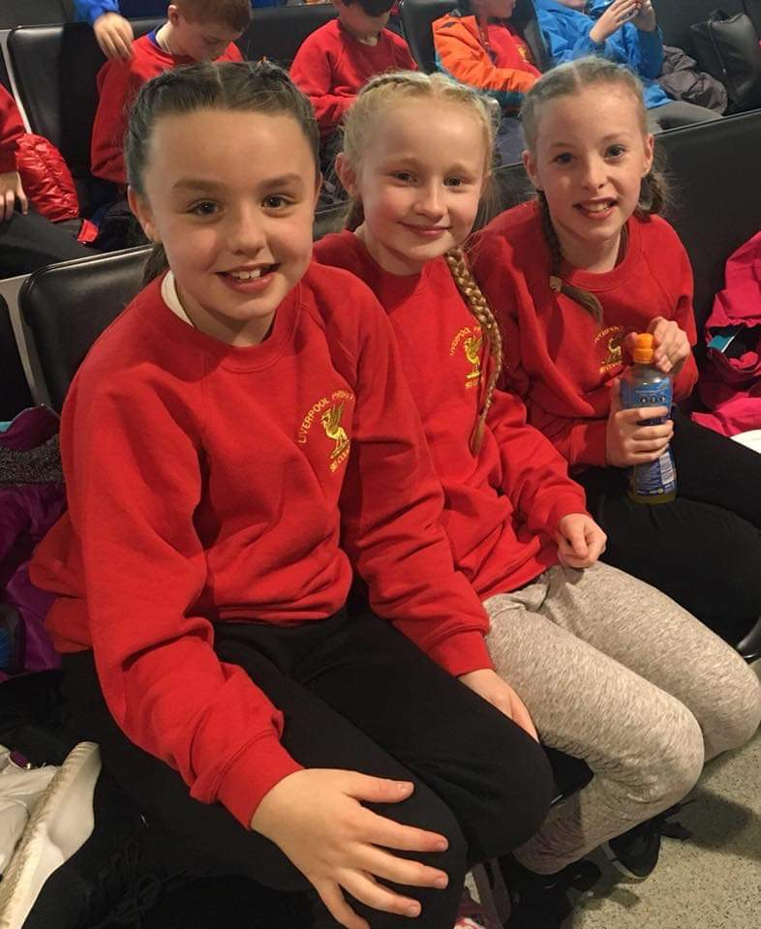
Travel clothes
All children must purchase a red Liverpool Primary Ski School sweatshirt from Ski Equip. This must be worn for the journey there and back. Staff wear blue sweatshirts.
Ski jackets must also be worn for travelling, this will be the only coat you need for the trip.

Slide 4
Rucksack for travelling
packed lunch x 2
inhalers (in clear plastic bag)
pair of ski socks
NO liquids
books, colouring or small games to play with on the flight and coach

Slide 5
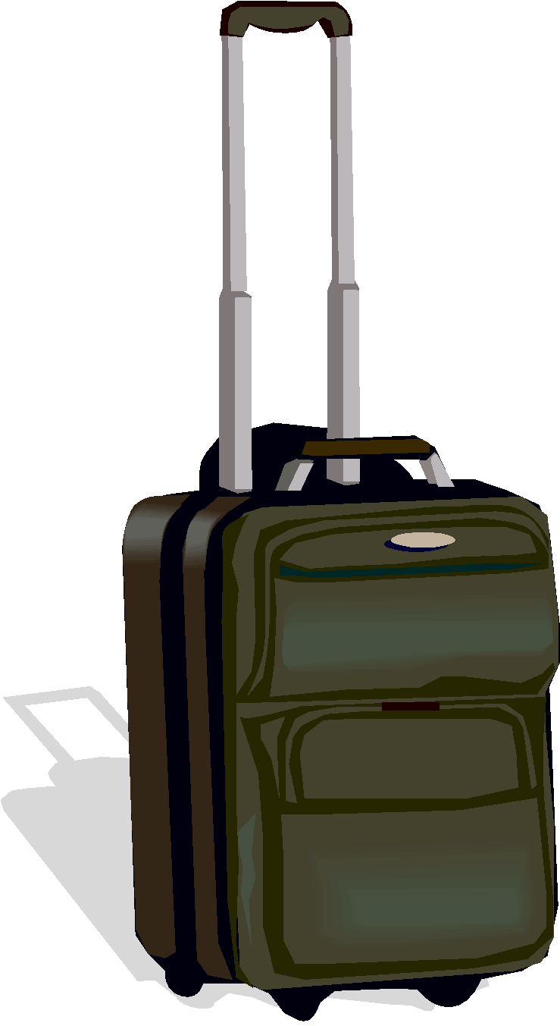
You will also need a small suitcase that you will have to carry yourself. Inside the case, you need to pack:
a Sports Direct ‘bag for life’ to keep your ski boots in every day
a small bottle of sanitiser
Please remember, no phones or electronic devices are allowed

Slide 6
What to pack
Make sure you have comfortable clothes for wearing when you are not skiing
Tracksuits or joggers are fine
The hotel is really warm so you don’t need lots of big jumpers
Bring slippers or sliders to wear indoors
Bring an outfit for the Disco night
You also need to remember to bring a towel
Toiletries

Slide 7
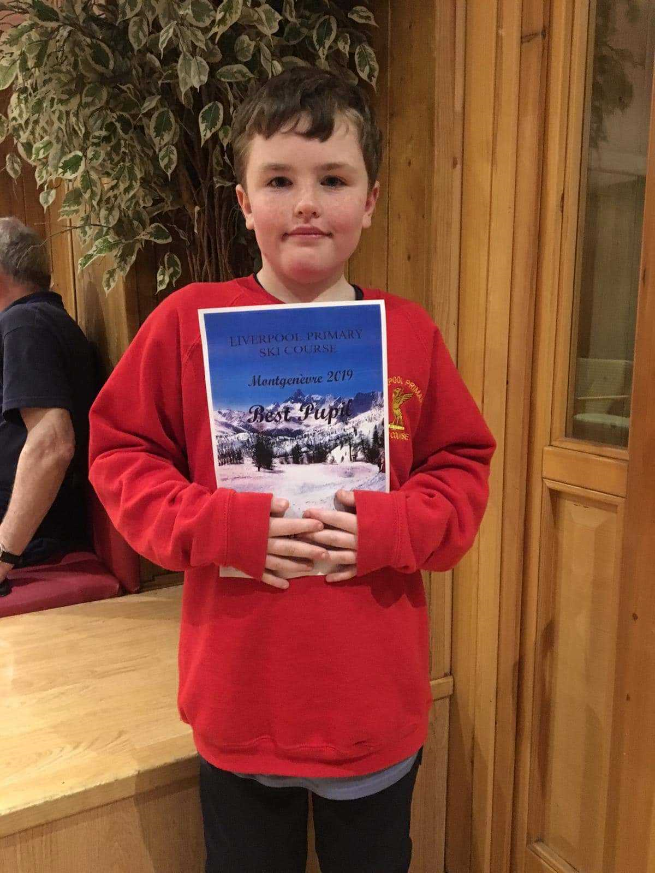
You can win lots of different awards every day and there are special awards at the end of the week. These awards are held every night while we are away.
Staff will post photographs at the end of each day on social media.

Slide 8
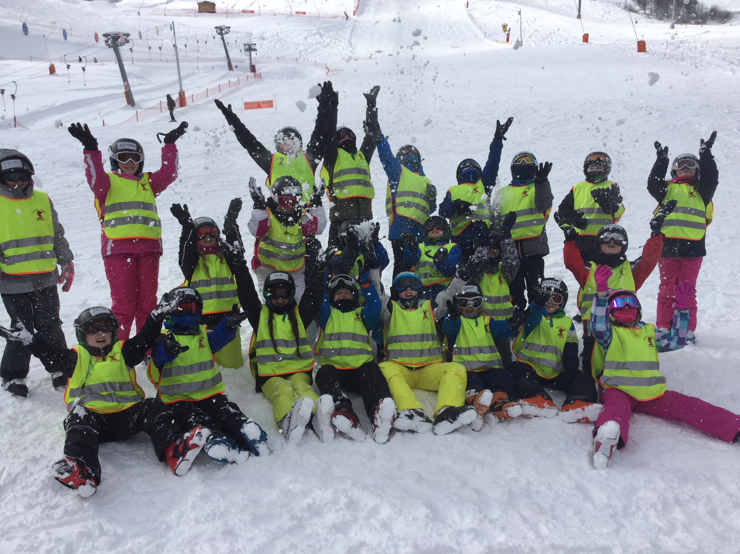
Final Meeting - Thursday 16th March
Passports
EHIC/GHIC card
English money £10 for water in airport
Euros - 80 euros (in separate envelopes)
Medication- please ensure this is labelled
Travel-sick tablets

Slide 9
Kit List
Face and lip suncream of 15 or higher factor
Sunglasses and Ski goggles
A warm covering for the neck
A warm base layer (top and bottoms)
Fleece for colder weather as a mid layer
Ski jacket which should be of waterproof
Ski gloves (these need to be big enough to fit at the time of the trip and should have the name written in)
Ski salopettes
Ski socks
Woolly hat

